Slide 1

Process Maps As Code
With mermaid
Richard Jackson | @jacksorjacksor
Umbraco Kent Meetup | 14th November 2024

Slide 2
CONTENTS
Introduction (“The meme that haunts”)
Code to visuals (“Graphic design for developers”)
Mermaid JS
Reflections (“Why bother?”)

Slide 3
ABOUT ME

Slide 4
The Meme that haunts

Slide 5
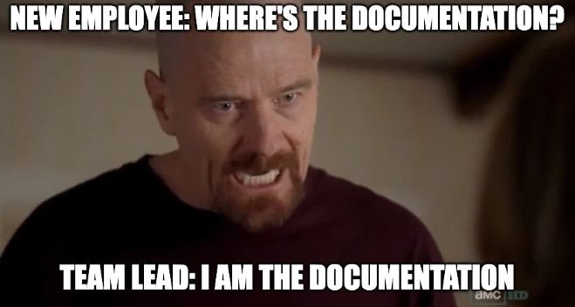

Slide 6
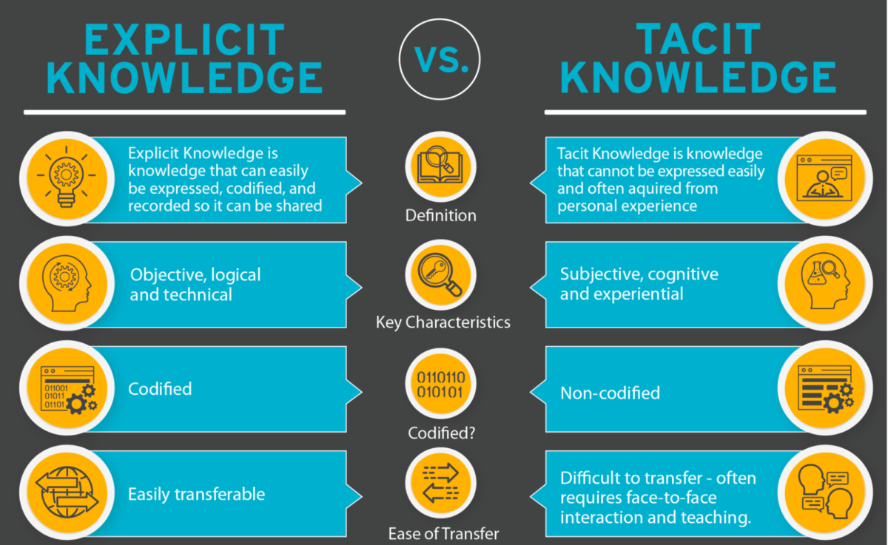
Source: https://document360.com/blog/explicit-knowledge/

Slide 7
Visual aids TO SUPPORT documentation
Placeholder:
TACIT KNOWLEDGE
“How could I have known that?”

Slide 8
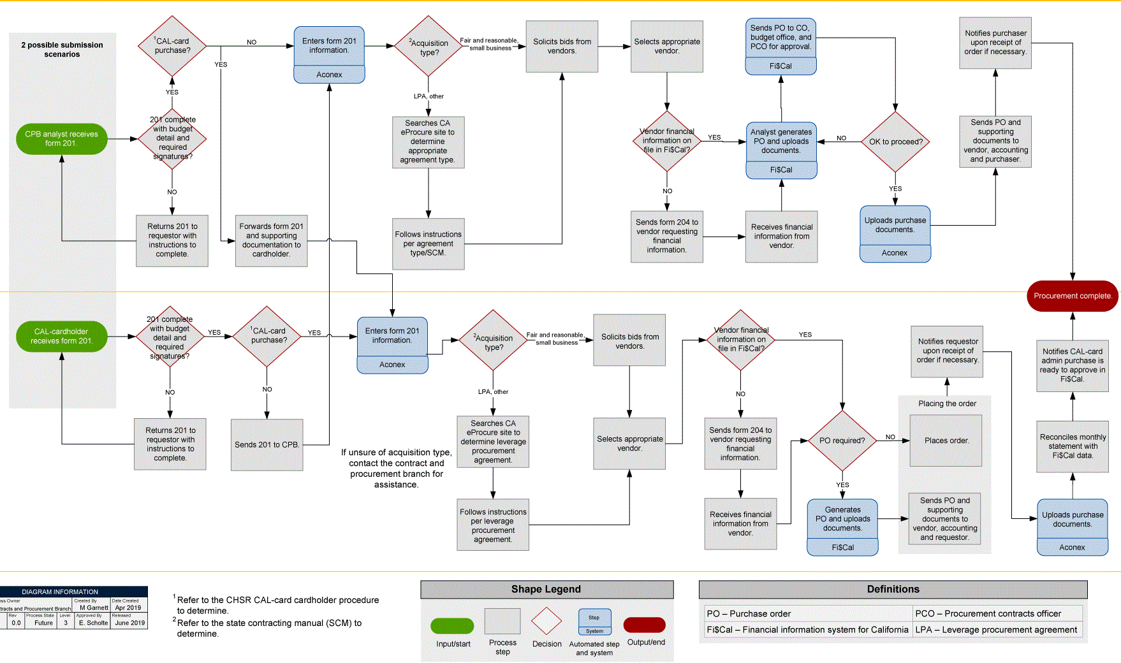
What is process mapping?
Creation of a visual representation of work
Communication exercise to define workflow, resources and responsibility
High-level, non-technical documentation which should be understandable across the business

Slide 9
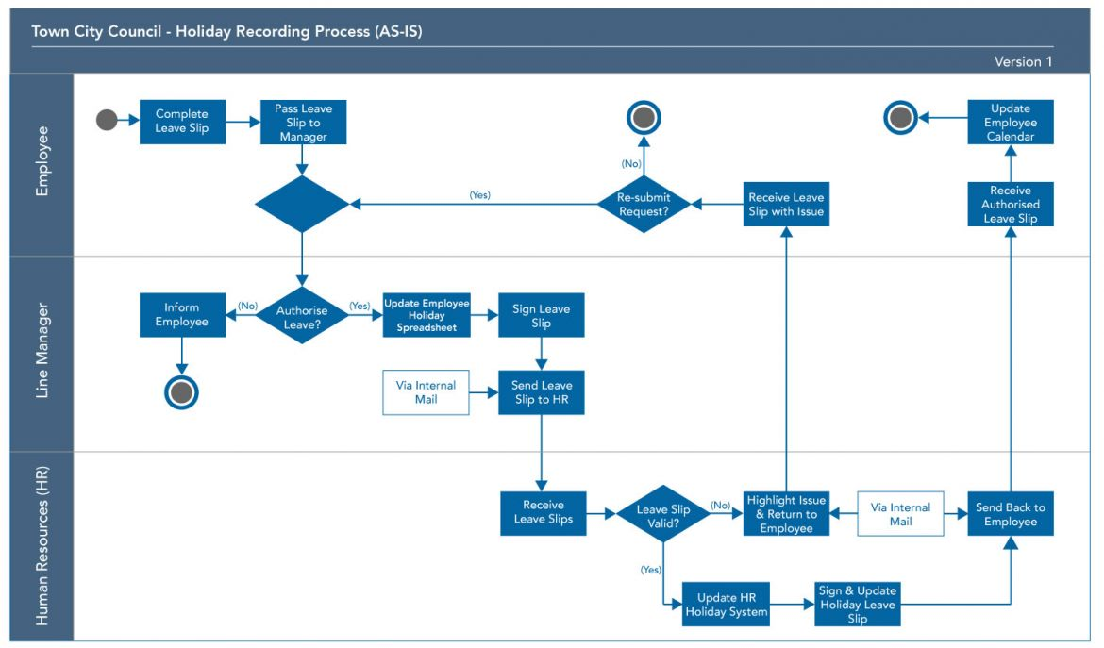
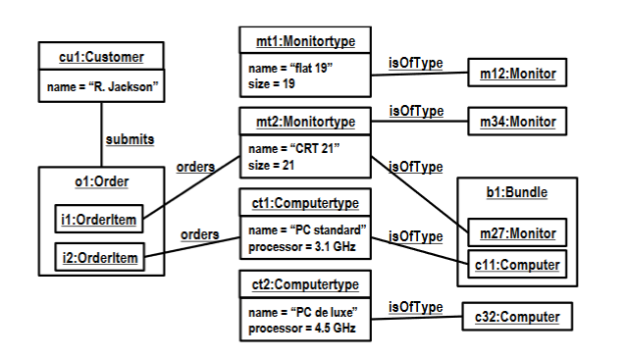
Different levels of process visualisation
Process Mapping
Process MODELLING
High-level
Subjective
Low-level
Objective

Slide 10

Benefits of process mapping
Provides single source of truth for discussion, iteration and improvement
Challenges assumptions
Reduces tacit knowledge
Improve onboarding of new staff
Creates empathy between departments

Slide 11

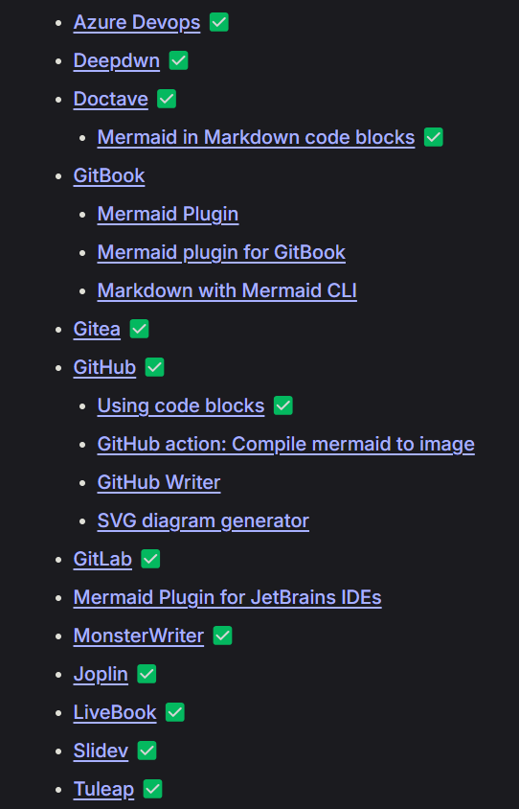
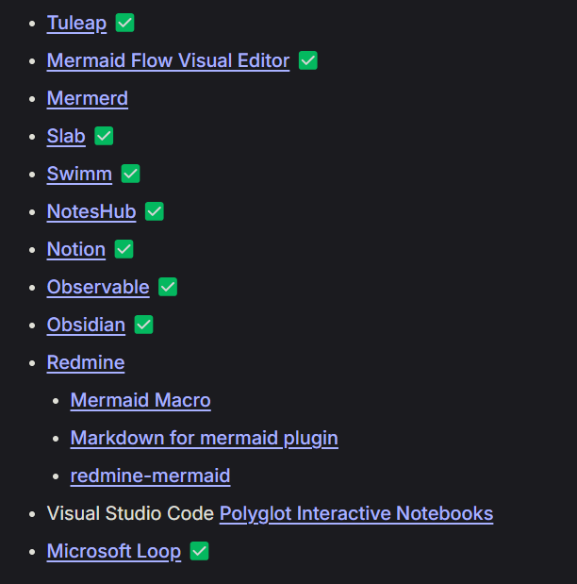
Mermaid JS Integrations
Native support for Mermaid

Slide 12
GitHub

Slide 13
Azure DevOps

Slide 14
GitHub

Slide 15
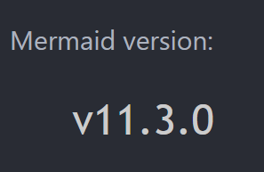
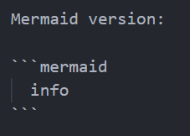
EXAMPLES
Code
Render
[name of file] > [name of rendering application]

Slide 16
Defining Shapes
Flowcharts Syntax | Mermaid

Slide 17
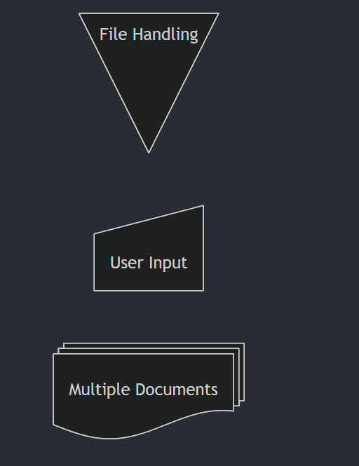
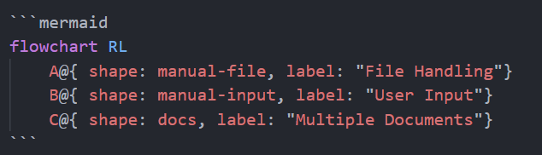
Defining Shapes
Flowcharts Syntax | Mermaid

Slide 18
Checking Versions
Code
Render
test.md > Visual Studio Code

Slide 19
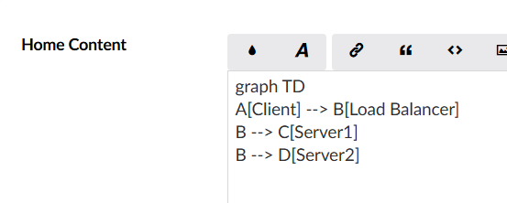
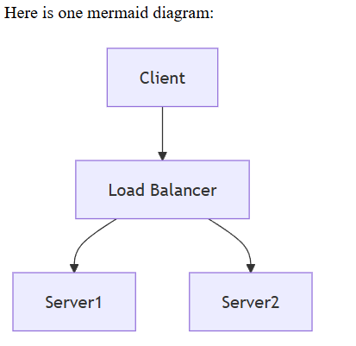
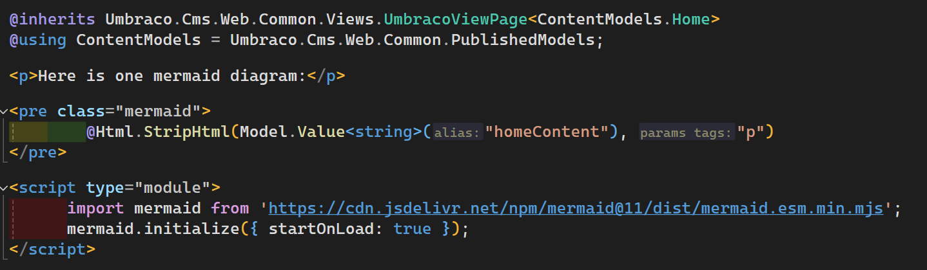
Umbraco CMS (v13)

Slide 21
Process Mapping Considerations
Maybe?

Slide 22
